Slide 1
OUTLINE:
INTRODUCTION
OVERVIEW AND OBJECTIVES
SYSTEM ARCHITECTURE
HARDWARE COMPONENTS
SOFTWARE ARCHITECTURE
SYSTEM WORKING AND DATAFLOW
CIRCUIT DESIGN AND CONNECTIONS
MOBILE APPLICATION INTERFACE
IMPLEMENTATION HIGHLIGHTS
TESTING, PERFORMANCE, AND OVERALL RESULTS
APPLICATIONS AND USE CASES
FUTURE SCOPE AND ENHANCEMENTS
CONCLUSION

Slide 2
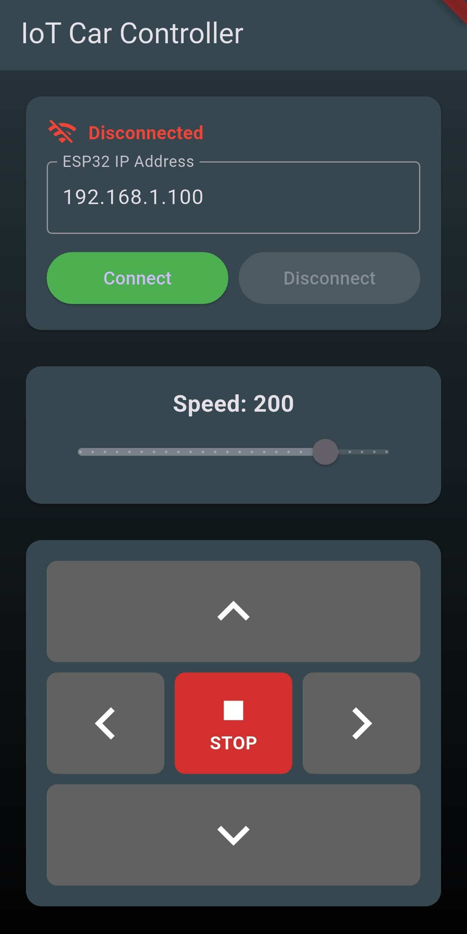
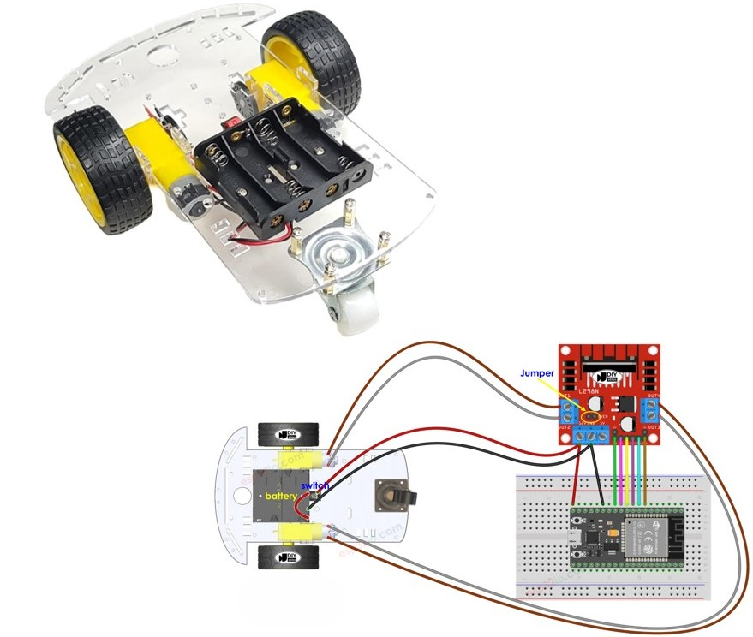
INTRODUCTION
IoT Integration in applications of Smart Vehicle control
Wireless operation through mobile devices using Wi-Fi communication
ESP32 microcontroller manages motor control and network communication
Real-time command execution with minimal latency

Slide 3
OVERVIEW AND OBJECTIVES:
Project Overview
IoT-enabled electric vehicle control system
ESP32-based wireless motor control
Cross-platform mobile application interface
Main Objectives
Develop an IoT-enabled vehicle control system
Implement wireless communication via Wi-Fi
Create a user-friendly mobile application
Demonstrate real-time remote control capabilities
Build a modular design for future enhancements

Slide 4
SYSTEM ARCHITECTURE
Three-Layer Architecture
Mobile Application Layer: Flutter app with Python/Flet library
Communication Layer: Wi-Fi HTTP request transmission
Control Layer: ESP32 + L298N motor driver + DC motors
Data Flow
Mobile App → Wi-Fi → ESP32 → L298N → Motors
Open-loop control system (no feedback sensors)
Real-time command processing
MobileApp
ESP32
L298N
Motors
Wi-Fi
GPIO
Power

Slide 5
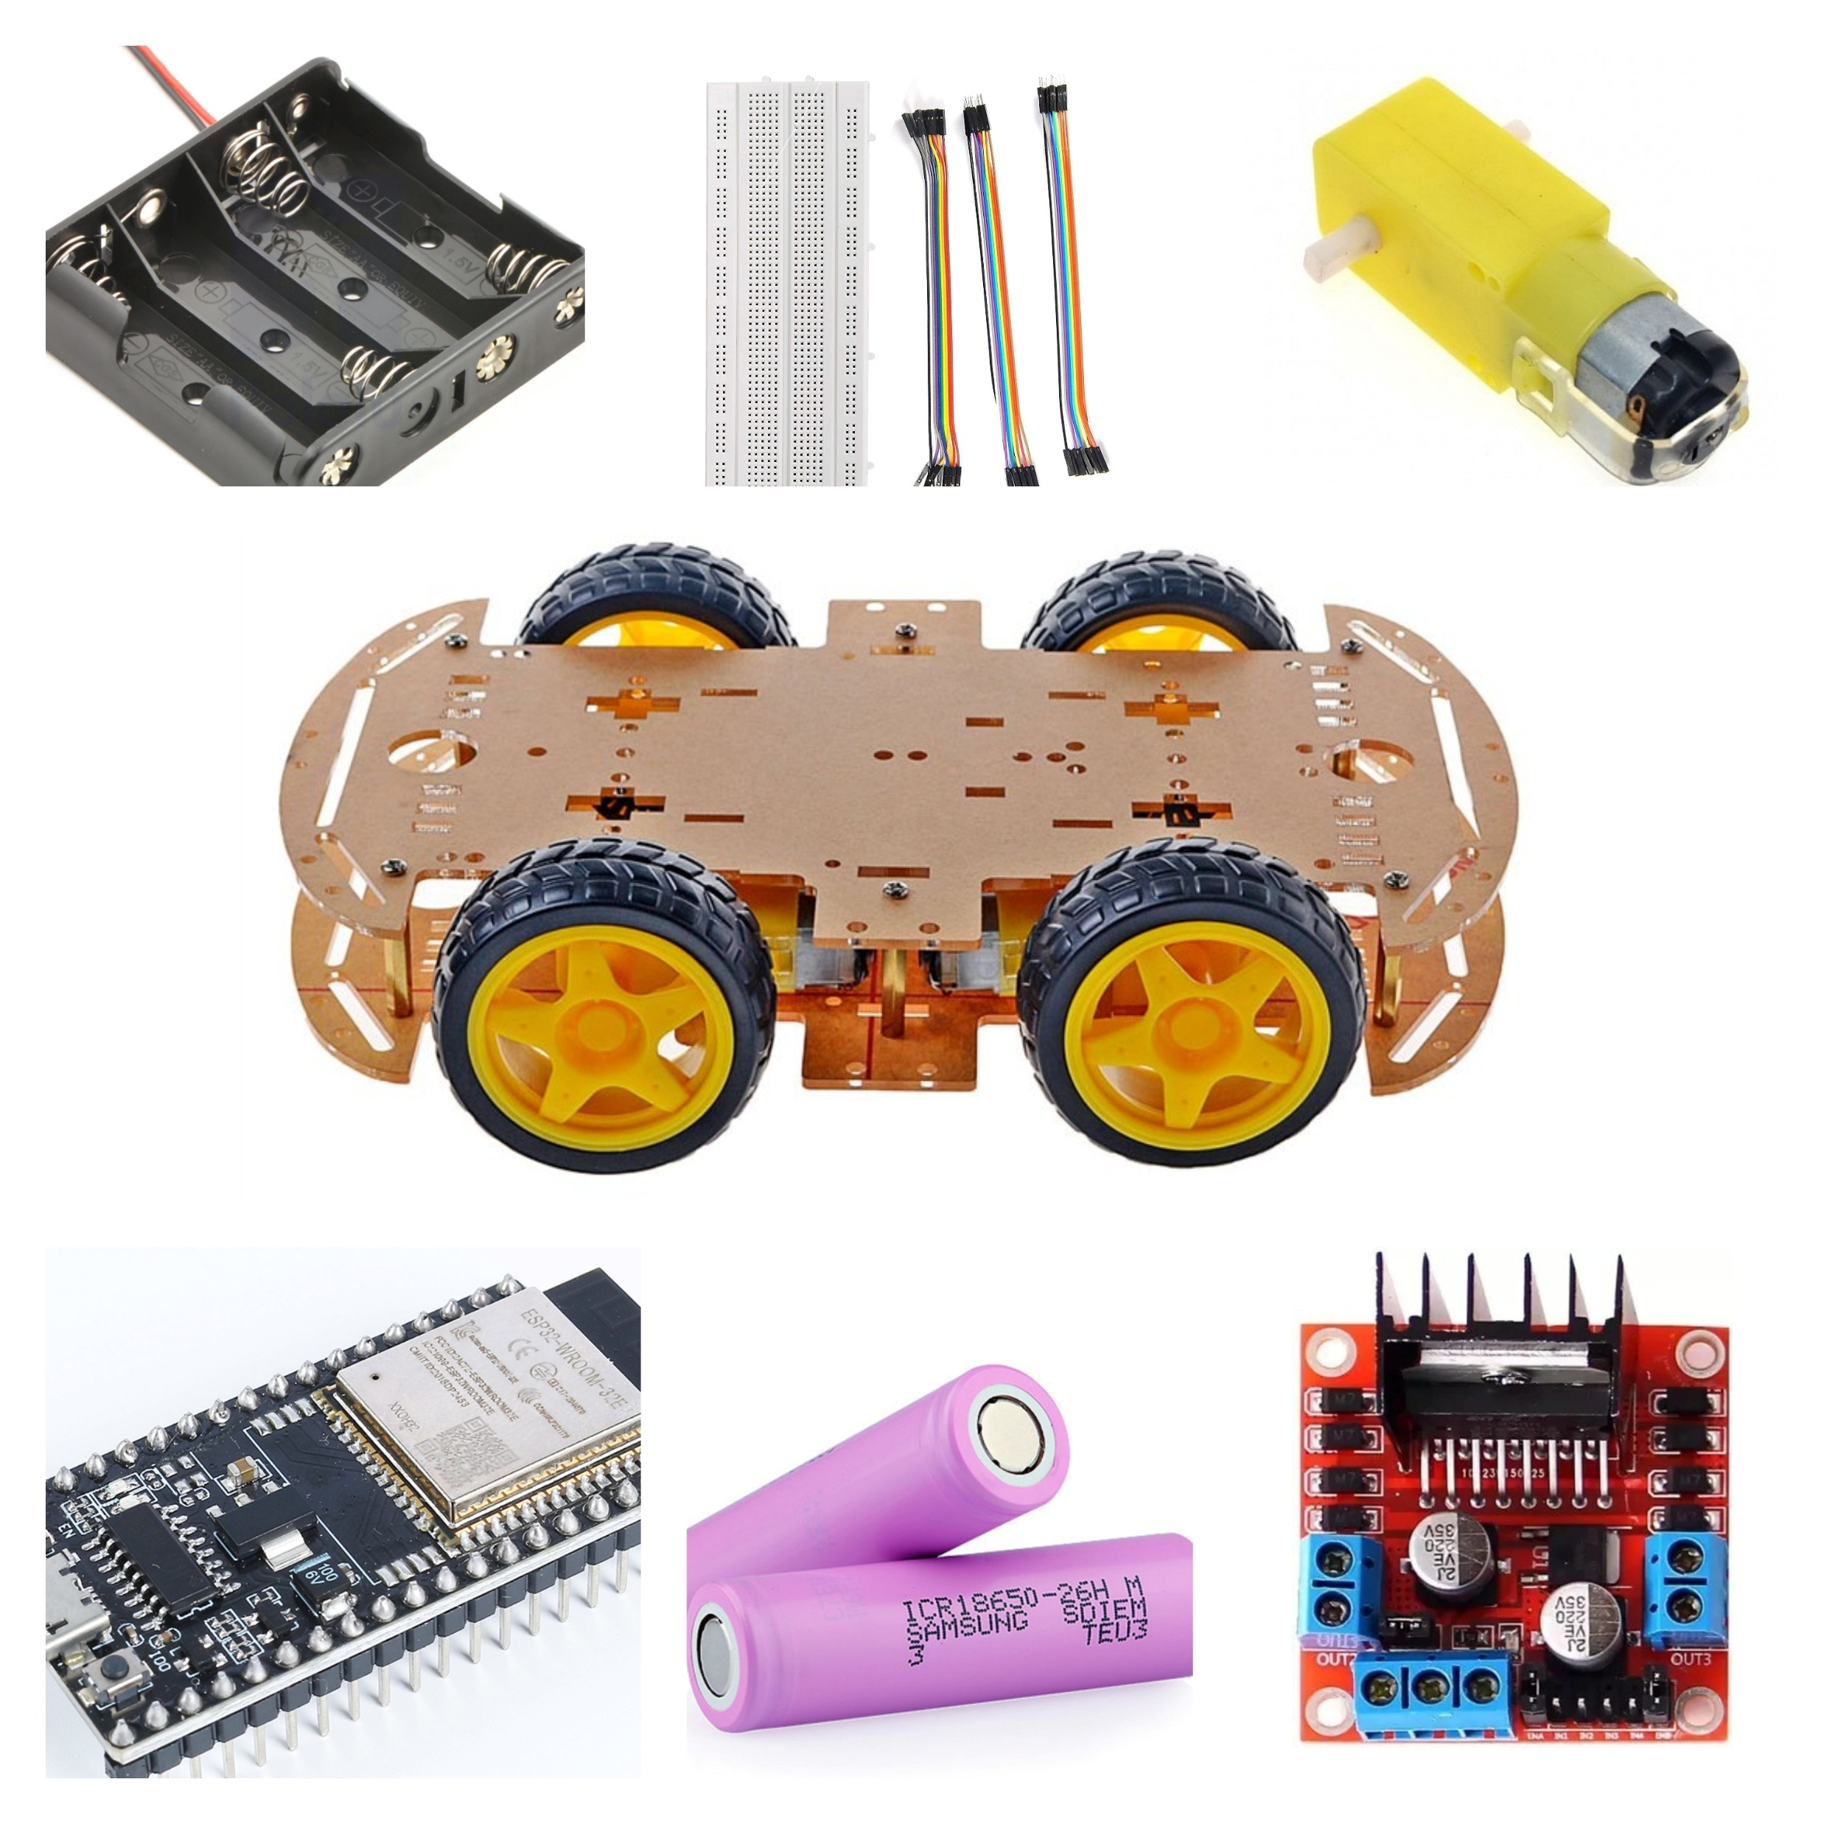
HARDWARE COMPONENTS
Core Components
ESP32 Microcontroller: Main controller with Wi-Fi capability
L298N Motor Driver: H-bridge configuration for bidirectional control
DC Motors: Vehicle propulsion system
Battery Pack: 4×AA or Li-ion power supply
Chassis & Wheels: Structural framework
ESP32 Specifications
Operating voltage: 3.3V, Clock: 240 MHz
Built-in Wi-Fi and Bluetooth
34 GPIO pins for interfacing

Slide 6
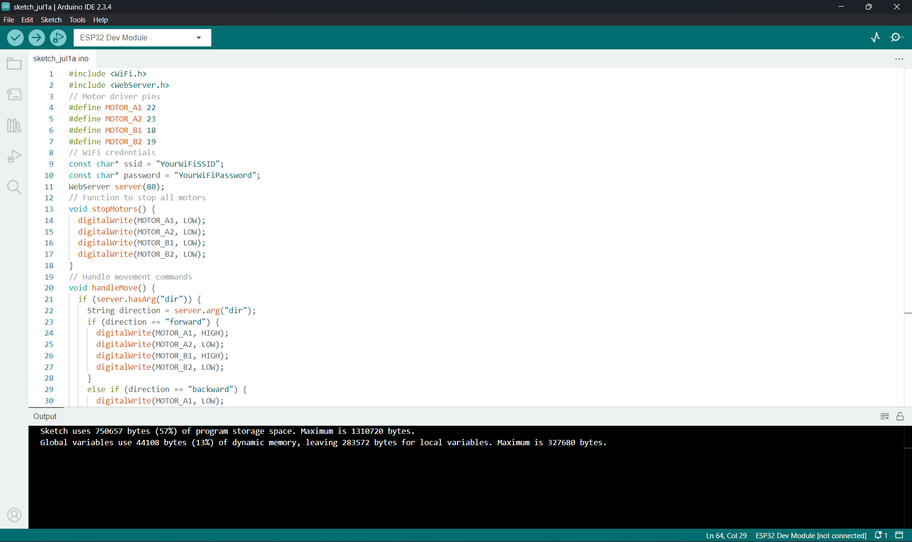
SOFTWARE ARCHITECTURE
Development Environment
Arduino IDE: ESP32 firmware programming
Python + Flet Library: Mobile application development
HTTP Protocol: Communication between app and ESP32
Key Libraries
ESP32: WiFi.h, WebServer.h, ArduinoJson.h
Mobile App: requests, flet
Cross-platform compatibility for
smartphones and tablets

Slide 7
SYSTEM WORKING AND DATAFLOW
System Working Flow
Initialization: ESP32 connects to Wi-Fi network and starts HTTP server
Connection: Mobile app establishes connection with ESP32 IP address
Command Generation: User button presses create HTTP GET requests
Processing: ESP32 receives and parses incoming commands
Motor Control: L298N driver executes movement based on GPIO signals
Data Flow Architecture
Mobile App → Wi-Fi → ESP32 → L298N → Motors
Real-time bidirectional communication between app and microcontroller
HTTP protocol ensures reliable command transmission
Open-loop control system with immediate response execution
No feedback sensors - commands executed without position verification
Sequence Flow Diagram:
[User Presses Button]
|
v
[Mobile App Creates HTTP GET]
|
v
[ESP32 Receives Request]
|
v
[ESP32 Parses Direction]
|
v
[ESP32 Sets GPIO Pins]
|
v
[L298N Activates Motors]

Slide 8
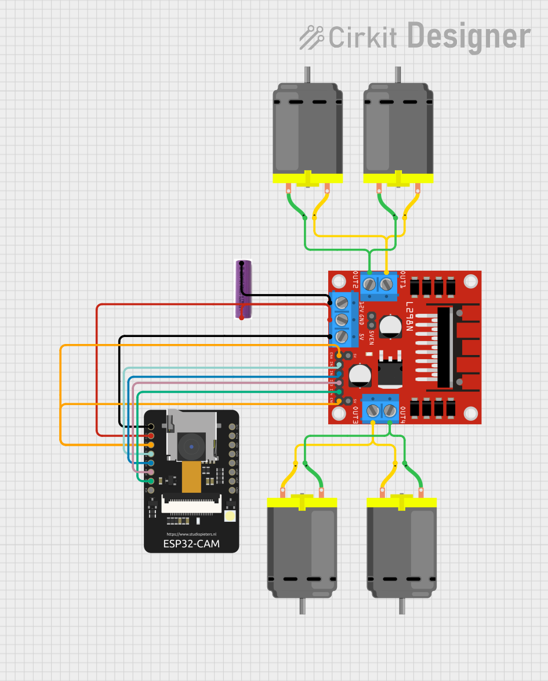
CIRCUIT DESIGN AND CONNECTIONS
Pin Mapping
ENA/ENB: Motor speed control (PWM)
IN1/IN2: Motor A direction control
IN3/IN4: Motor B direction control
GPIO pins: 2, 4, 5, 18, 19, 21
Circuit Features
H-bridge motor control configuration
Isolated power supply for motors and ESP32
Protection diodes in the L298N module
Modular connection design

Slide 9
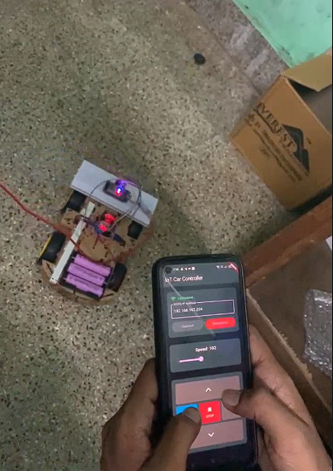
MOBILE APPLICATION INTERFACE
User Interface Features
Simple button layout: Forward, Backward, Left, Right, Stop
Real-time status display: Command confirmation
Cross-platform compatibility: Works on smartphones/tablets
Responsive design: Immediate visual feedback
Technical Implementation
Python with Flet library for Flutter UI
HTTP request generation for each button press
Error handling for connection issues
Status updates for user feedback

Slide 10
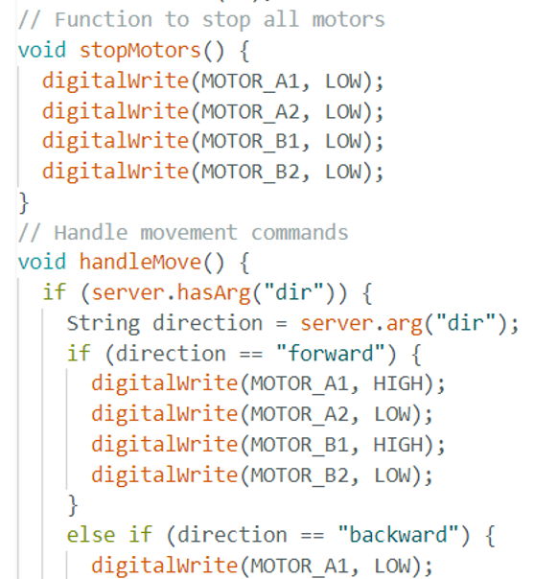
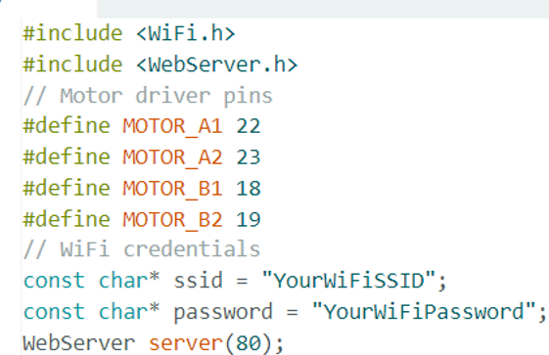
IMPLEMENTATION HIGHLIGHTS
ESP32 Firmware Key Features
// Wi-Fi initialization
WiFi.begin(ssid, password);
// HTTP server setup
WebSocketsServer webSocket = WebSocketsServer(81);
// Motor control functions
void carForward() { /* Motor control logic */ }
Void carBackward() { /* Motor control logic */ }
Mobile App Implementation
def send_command(direction):
url = f"http://{ESP32_IP}/move?dir={direction}"
requests.get(url)

Slide 11
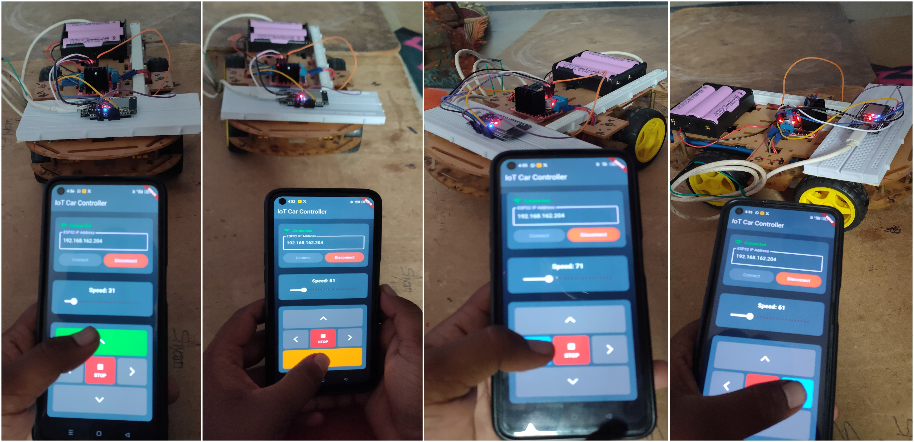
TESTING, PERFORMANCE, AND OVERALL RESULTS
Testing Methodology
Hardware Testing: Individual component verification
Software Testing: Firmware and app validation
Integration Testing: Complete system functionality
Performance Metrics
Response Time: <300ms command execution
Control Range: 5-8 meters indoor testing
Connection Stability: 15-20 minutes
continuous operation
Command Accuracy: 100% successful execution
Results Summary
Reliable wireless communication achieved
Accurate directional control in all modes
Stable operation without disconnects

Slide 12
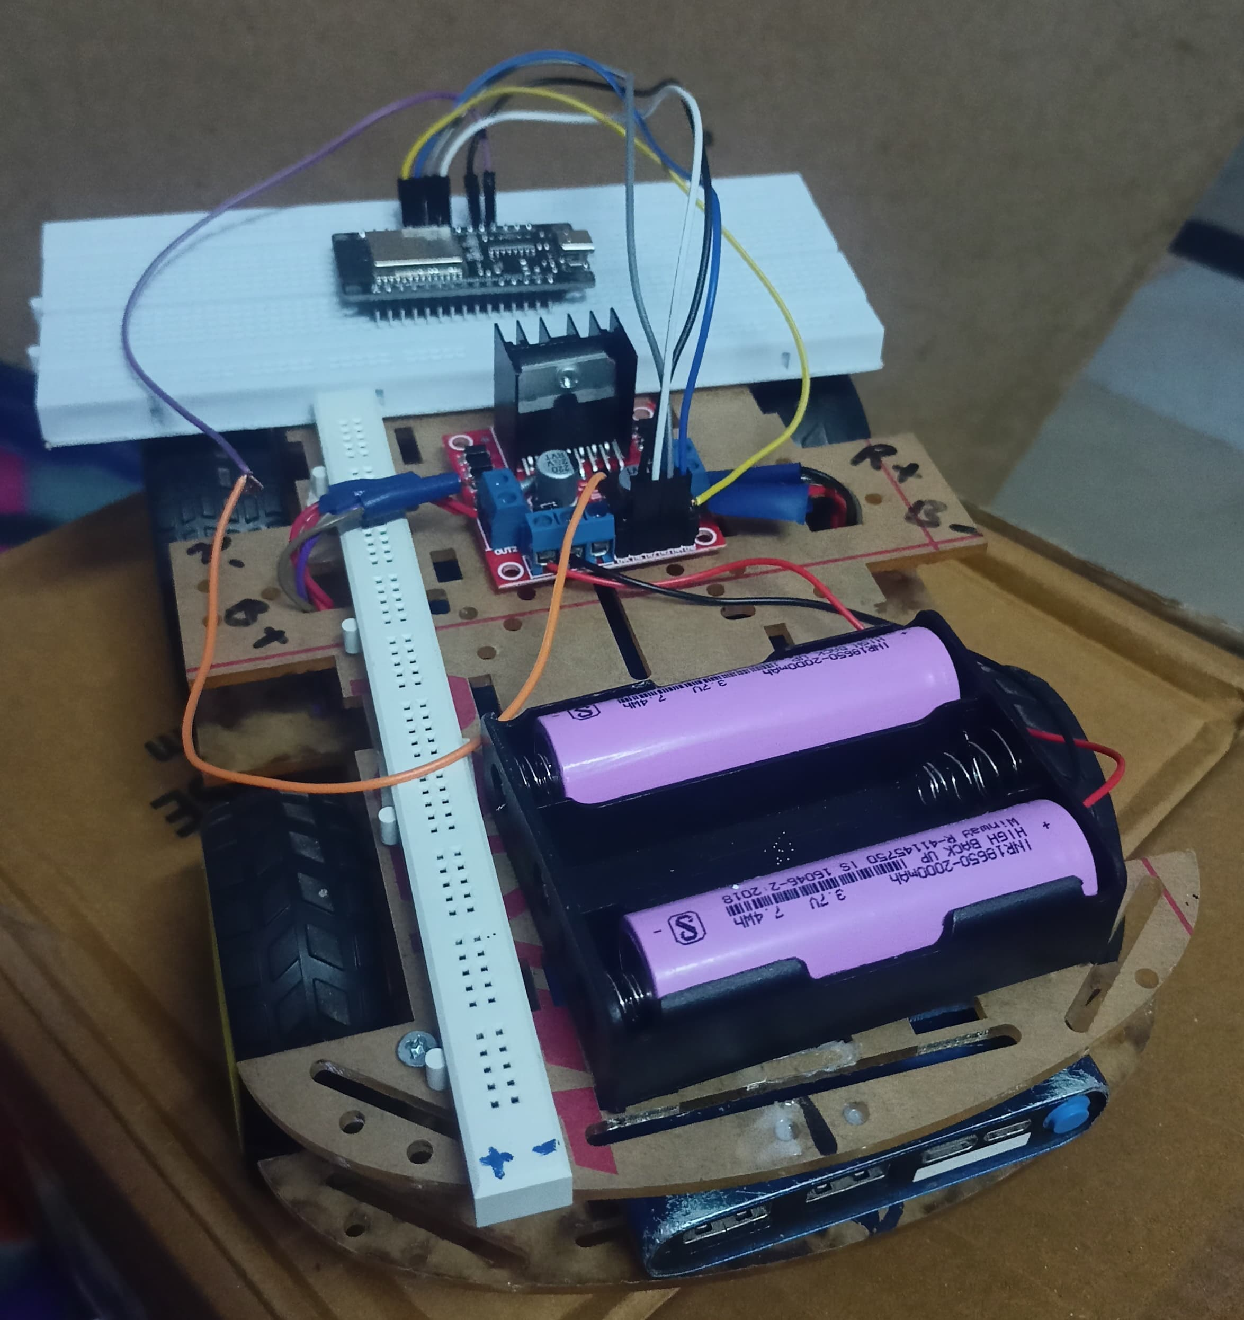
The above show’s the final prototype/design of this project

Slide 13
APPLICATIONS AND USE CASES
Educational Applications
IoT concept demonstration in academic settings
Embedded systems learning platform
Wireless communication practical implementation
Prototype Development
Autonomous vehicle research foundation
Remote-controlled robotics applications
Small-scale delivery systems prototype
Industrial Applications
Surveillance robots for security monitoring
Remote inspection vehicles for hazardous areas
Warehouse automation systems

Slide 14
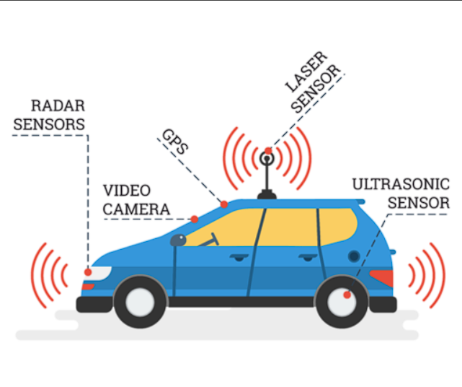
FUTURE SCOPE AND ENHANCEMENTS
Autonomous Features
Obstacle detection using ultrasonic sensors
Camera integration for visual feedback
Path planning algorithms for navigation
Advanced Connectivity
Voice control integration
Cloud database for data logging
Extended range with BLE/Long-range Wi-Fi
Enhanced Features
Battery monitoring system
Security authentication mechanisms
Multi-vehicle control capability

Slide 15
CONCLUSION:
Project Success
Successfully demonstrated IoT-based vehicle control
Achieved real-time wireless operation through mobile app
Validated stable communication between ESP32 and mobile device
Created a scalable foundation for future enhancements
Technical Achievements
Effective integration of embedded systems with mobile technology
Minimal latency in command execution
User-friendly interface for intuitive control
Modular design supporting future improvements
Learning Outcomes
Practical IoT implementation experience
Embedded systems and wireless communication understanding
Cross-platform mobile development skills
Hardware-software integration expertise

Slide 16
THANK YOU

